Slide 1
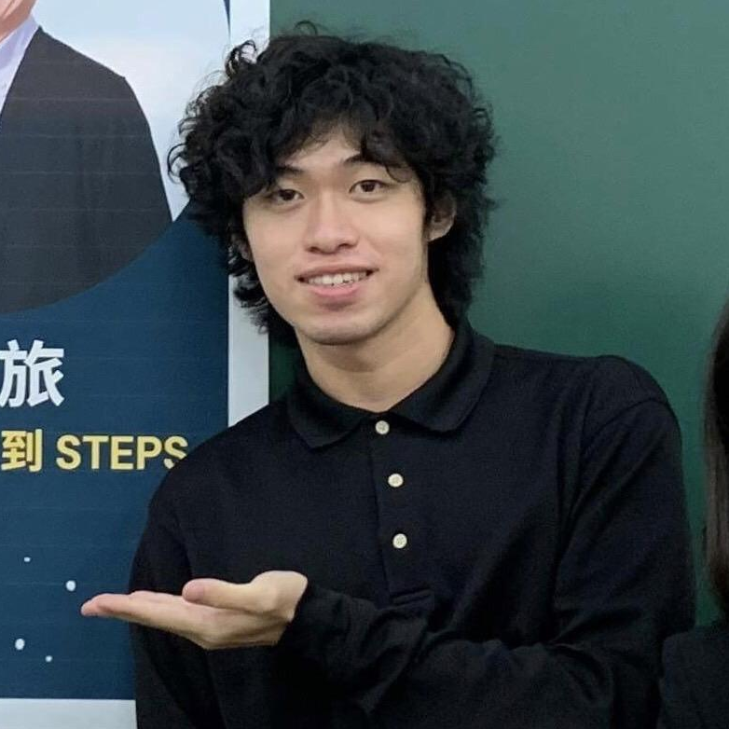
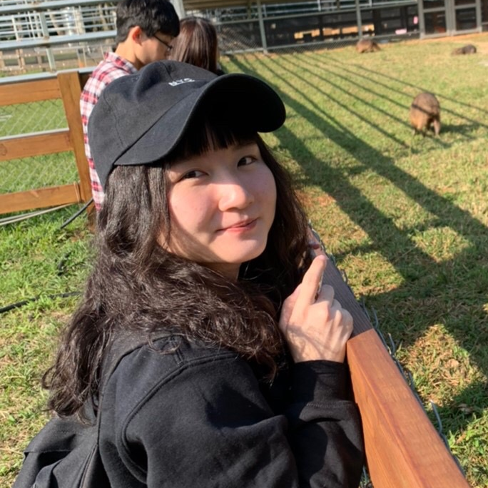
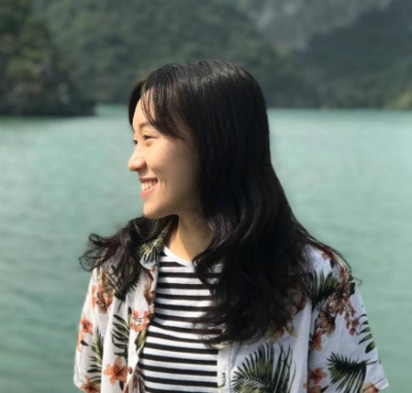
Group5
Leo Shr
NTHU ISS 110
110078509
Karen Chiu
NTHU ISS 110
110078506
Joanne Lee
NTHU ISS 110
110078501

Slide 2
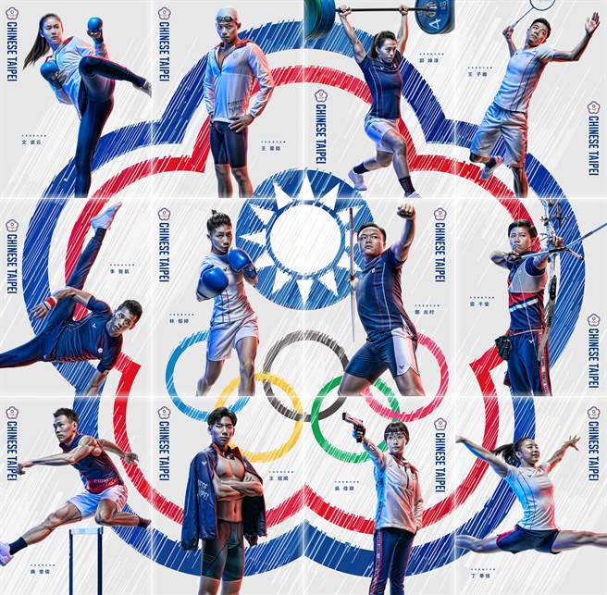

Background
In Tokyo Olympics, Chinese Taipei won a total of 12 Olympic medals, including 2 gold medals, 4 silver medals, and 6 bronze medals. That was the best record since the 1984 Los Angeles Summer Olympics.

Slide 3
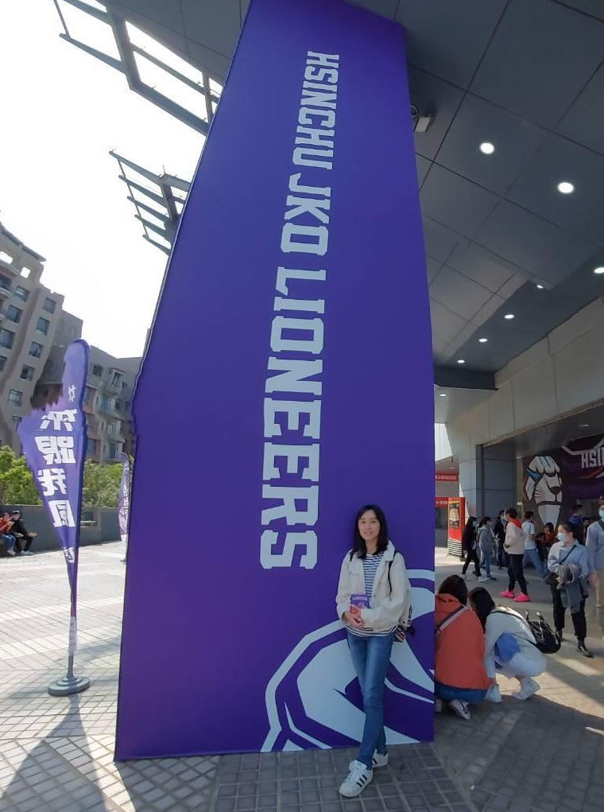
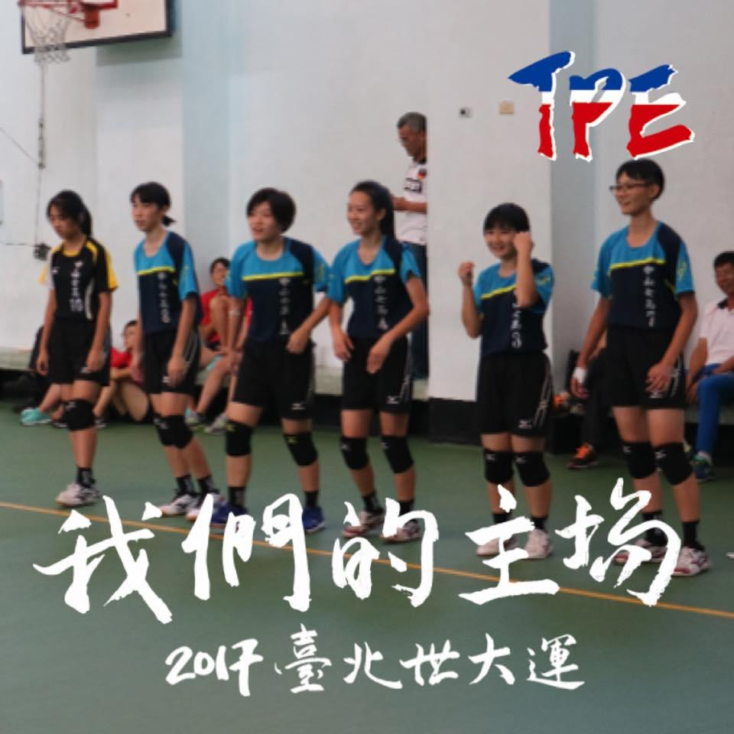
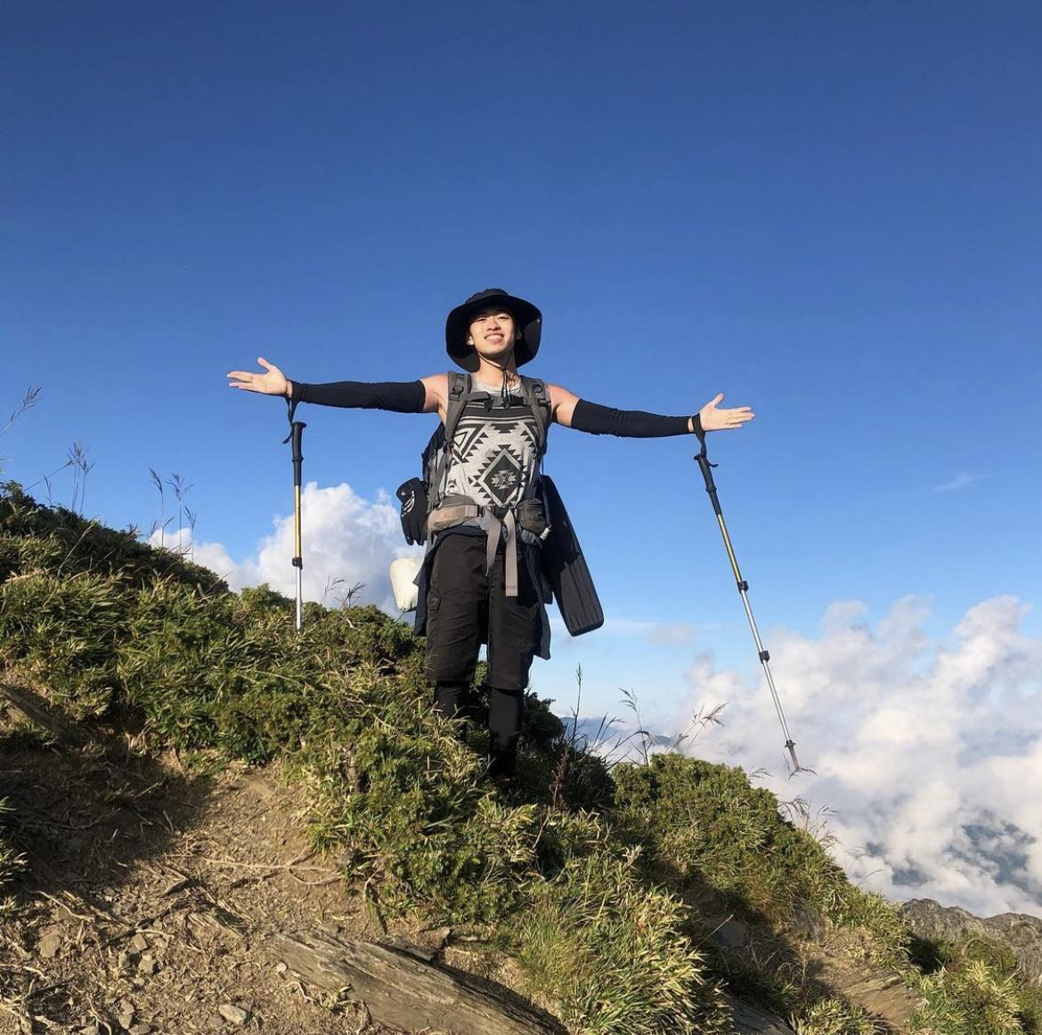
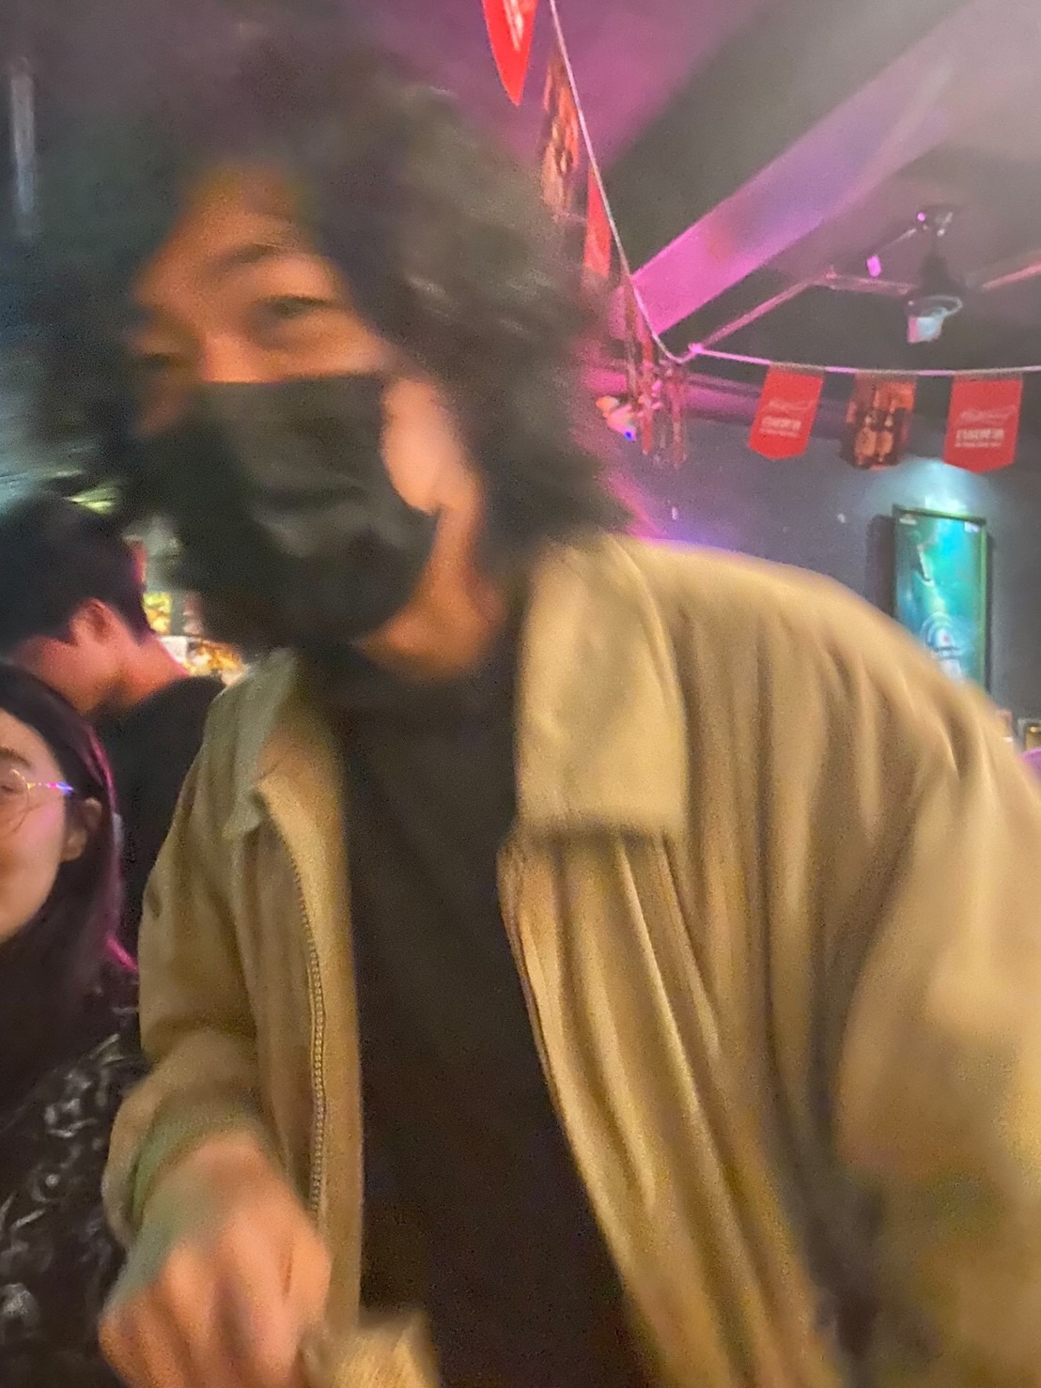
Motivation & Objective
We love sport!
We enjoy watching sports events!
We support Taiwanese athletes!
To discover public awareness of Taiwanese sport events and athletes.
我們也熱衷酒精運動！

Slide 4
Motivation & Objective
We enjoy Taiwanese sports events and support Taiwanese athletes!
To discover public awareness of Taiwanese sport event and athletes.

Slide 5
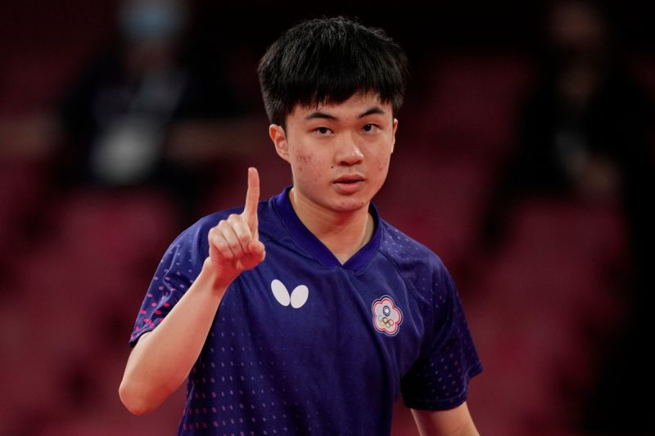
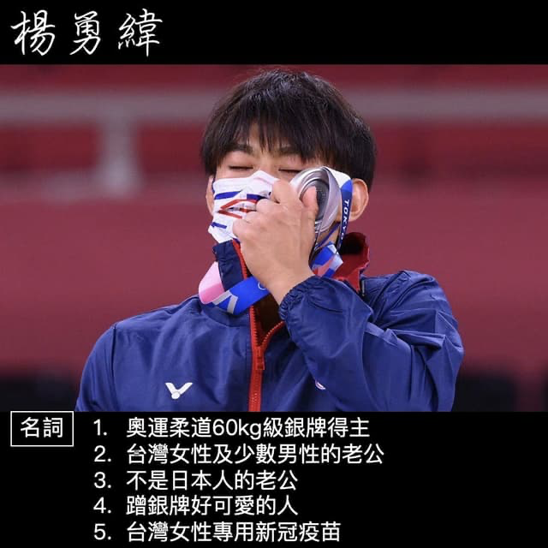
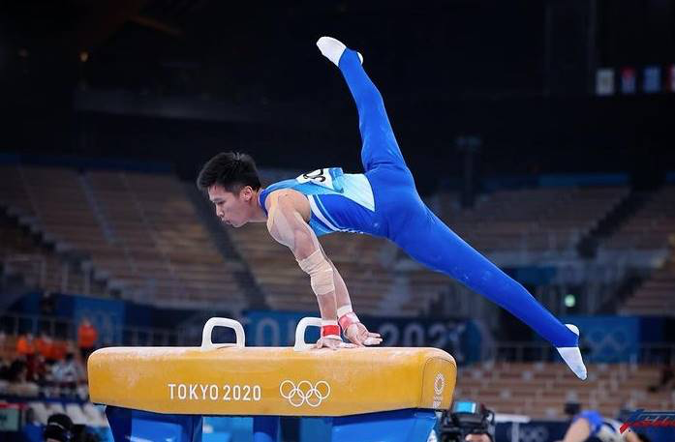
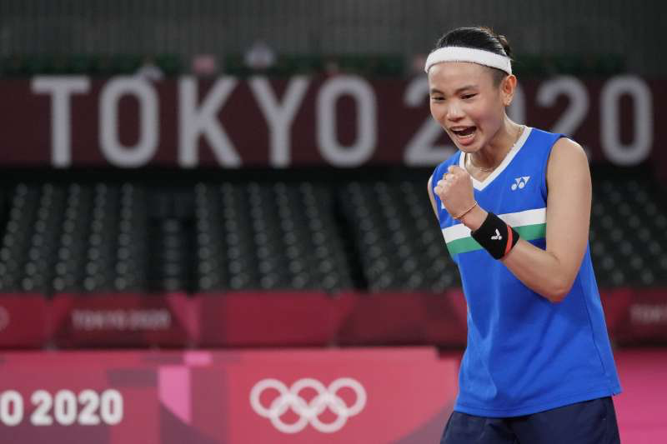
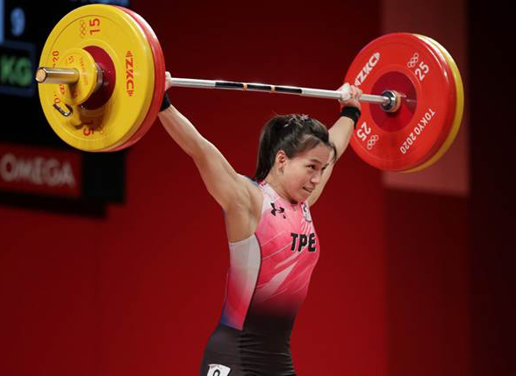
Topic
What do people think of Taiwanese athletes?

Slide 6
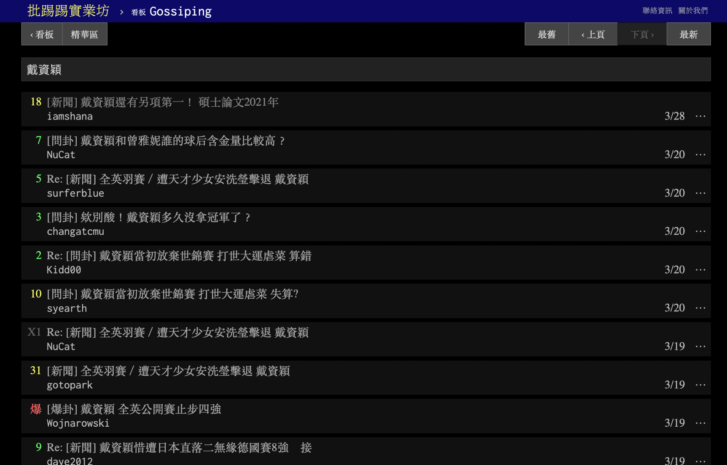

Data Source
PTT Gossiping
Name of athlete
Tai Tzu-Ying (戴資穎)
Lin Yun-Ju (林昀儒)
Kuo Hsing-Chun (郭婞淳)
Lee Chih-Kai (李智凱)
Yang Yung-wei (楊勇緯)

Slide 7
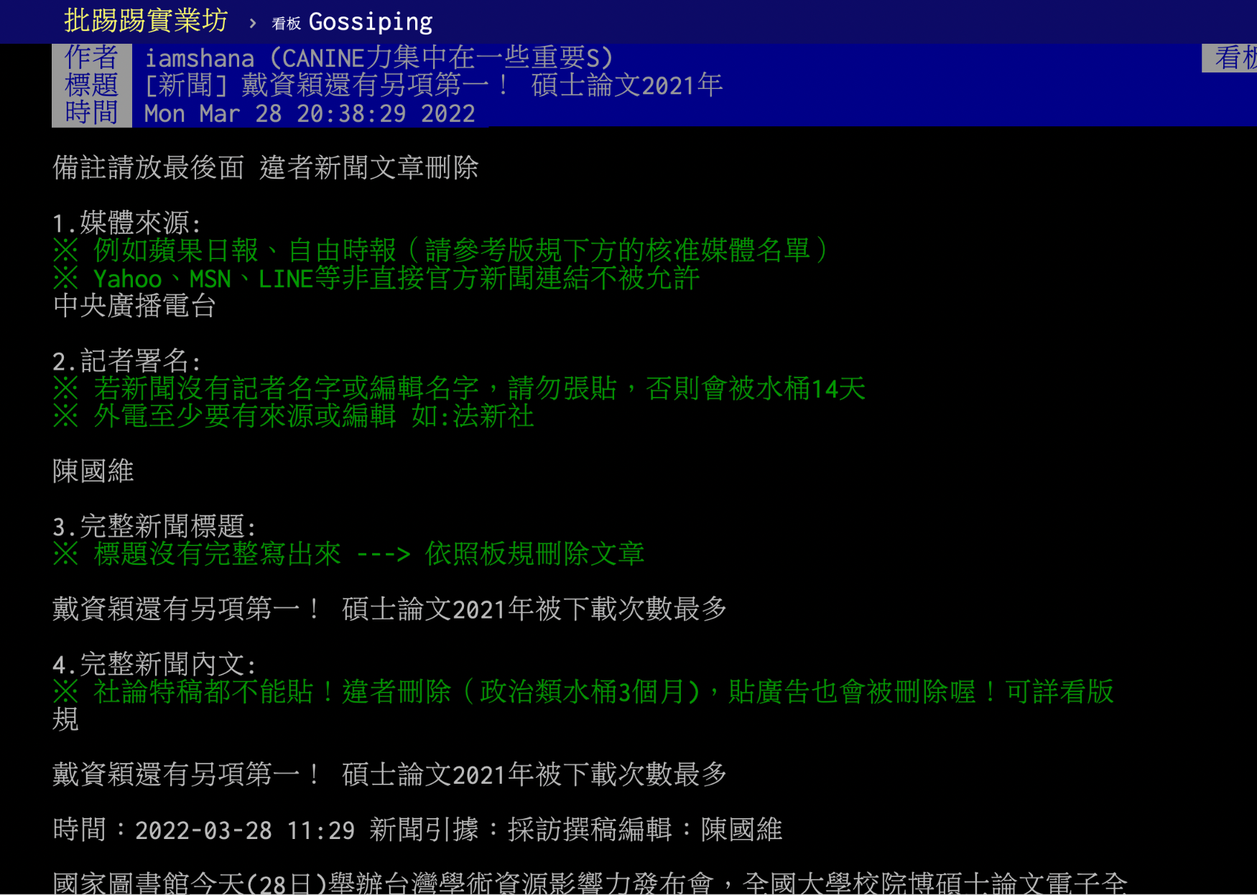
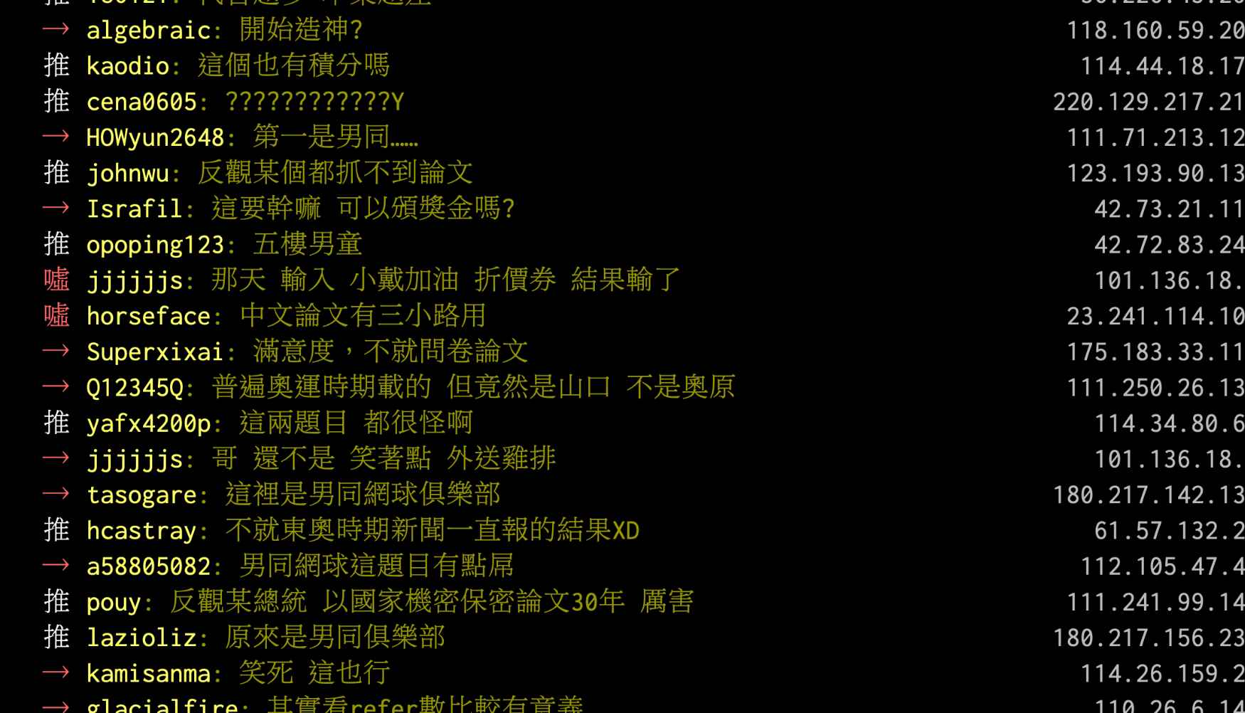
Data Structure
Athor / Title / Time
Content of article
Comments

Slide 8
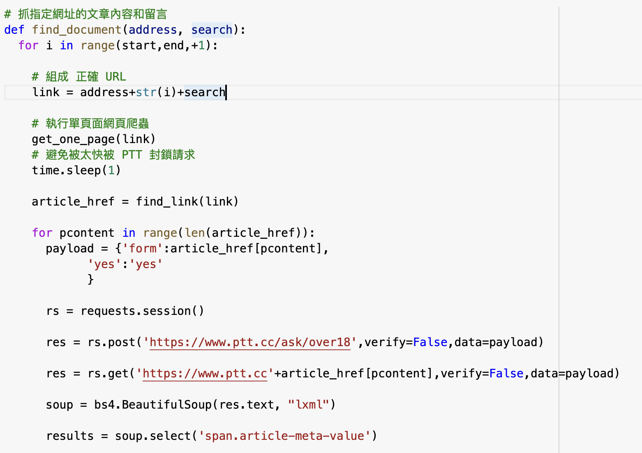
Technique
Web scrapping
BeautifulSoup

Slide 9
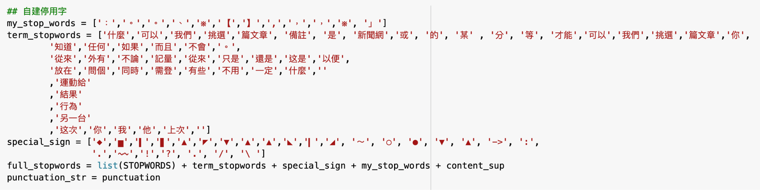
Technique
Tokenization CKIP
Define our stop words

Slide 10
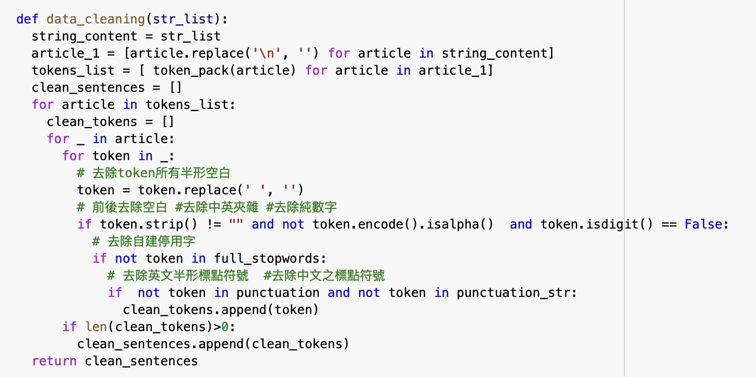
Technique - Data Cleaning

Slide 11
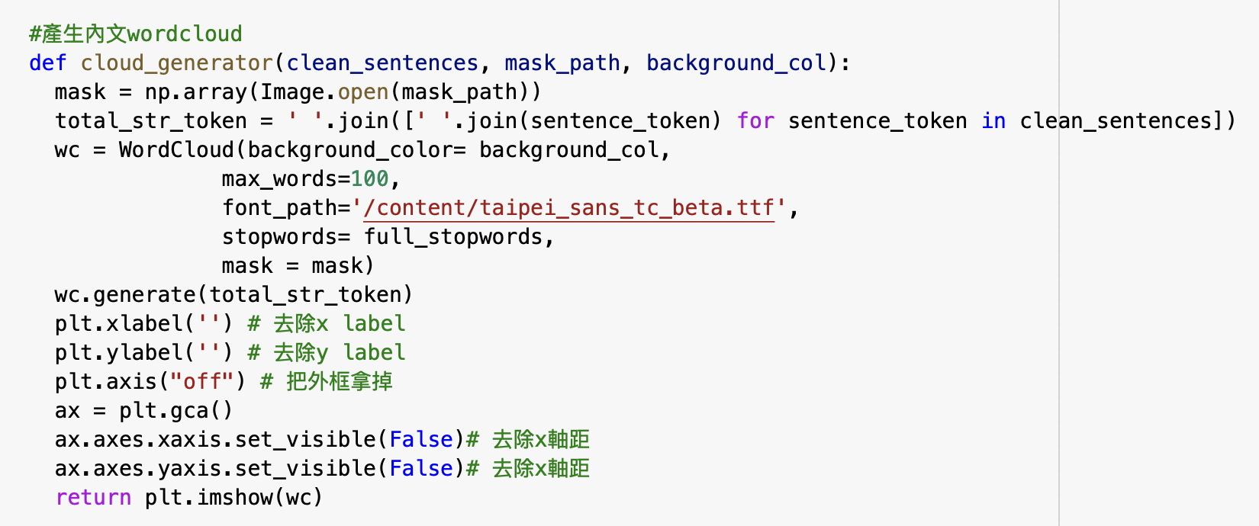
Technique - Text Cloud

Slide 12
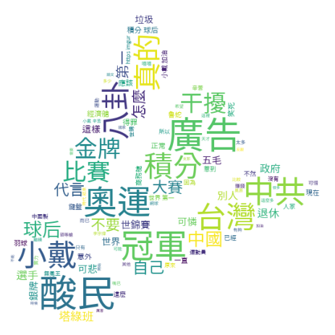
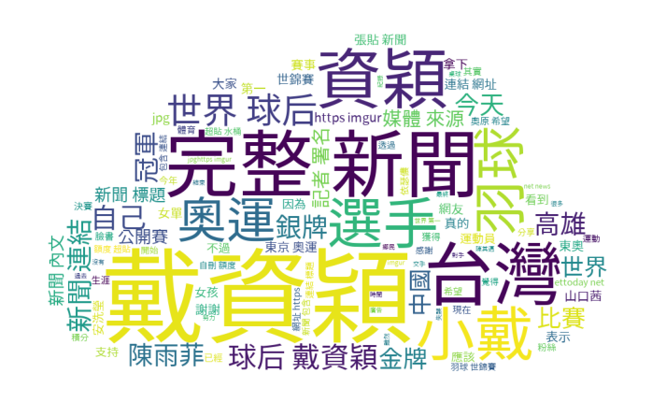
Outcome-Tai Tzu-Ying (戴資穎)
Content of Articles
Comments

Slide 13
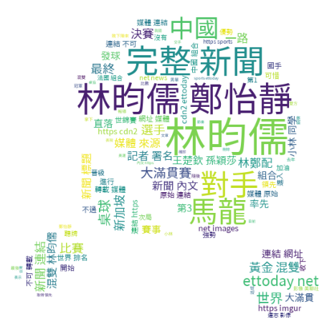
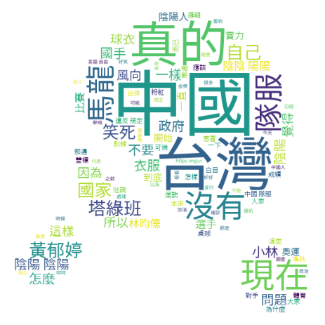
Outcome-Lin Yun-Ju (林昀儒)
Content of Articles
Comments

Slide 14
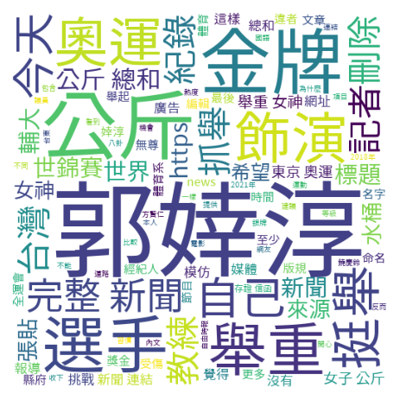
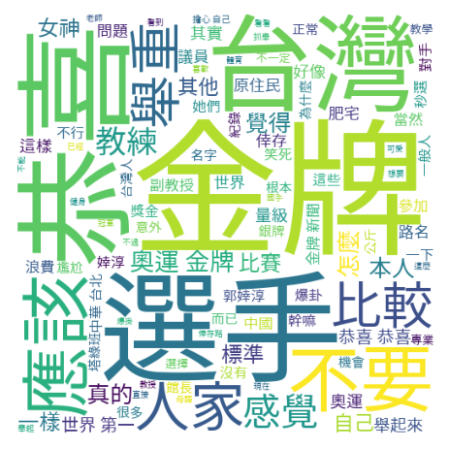
Outcome-Kuo Hsing-Chun (郭婞淳)
Content of Articles
Comments

Slide 15
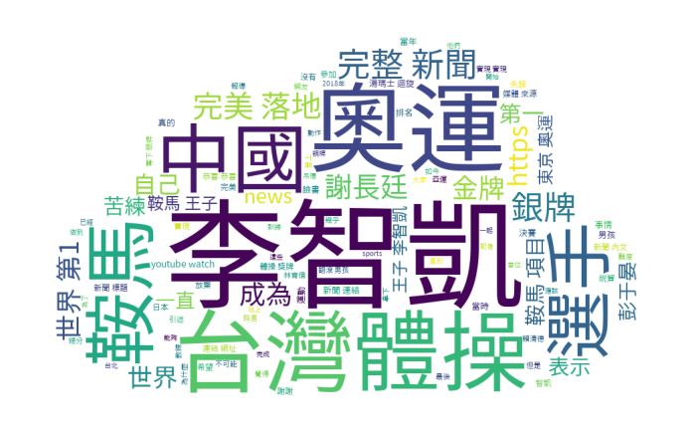
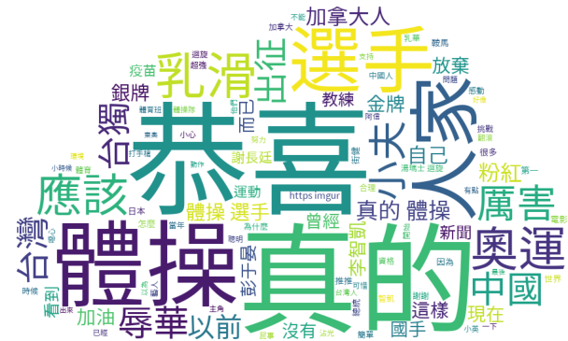
Outcome-Lee Chih-Kai (李智凱)
Content of Articles
Comments

Slide 16
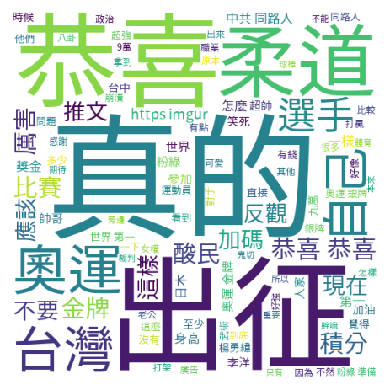
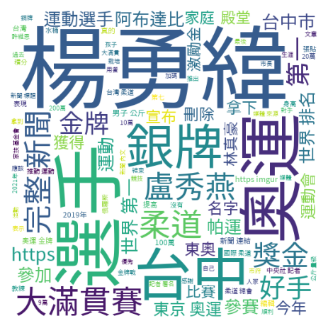
Outcome-Yang Yung-wei (楊勇緯)
Content of Articles
Comments

Slide 17
Summary

Slide 18
Future Plan
Discover the discussion trend
How often or how long did the Taiwanese discuss athletes?
Automatic Cache Function
Function 1: Build the temp.folder to store the scraping content
Function 2: Reset the colab path for internal cache
Time info extraction
Explore how forgetful netizens are.
Sentiment analysis on the comments
Analyzing the sentiment of comments helps us to learn more about whether the Taiwanese view athletes positively or negatively.

Slide 19
Group 5
hank You
Thank you
See you on 4/12 !
See you 4/12 !

Slide 20
What do Taiwanese people think of athletes?
Searched for some famous Taiwanese athletes’s articles
Source: PTT
Title
Content of articles
Comments
Tool
BeautifulSoup

Slide 21


SECond
Next Steps?

